Slide 1
Introduction to NS2

Slide 2
Network Simulator 2 (NS2) is an object-oriented, discrete event network simulator developed at UC Berkely
Written in C++ and Otcl (Tcl script language with Object-oriented extensions developed at MIT)
Network Simulator : A package of tools that simulates behaviour of networks.
NS2 Creates Network Topologies
It analyzes events to understand the network behavior
It is used to implement
- Network protocols such as TCP and UPD
- Traffic source behavior such as FTP, Telnet and CBR,
- Router queue management mechanism such as Drop Tail, RED and CBQ,
- Routing algorithms such as AODV, AOMDV, Link State...etc.,

Slide 3
Network Animator (NAM):
A visual aid showing how packets flow along the network .
Apart from having a trace file, it comes with a Network animator tool that allows visualization of nodes.
Simulators:
NS2-Network Simulator-2
NS3-Network Simulator-3
QualNet

Slide 4
1. To open a page and write tcl script
syntax : vi filename.tcl
2. To run the script
syntax: ns filename.tcl
3. NS2 script start with creating simulator object
syntax: set ns [new Simulator]
4. To open a nam trace file
syntax: set nf [open o.nam w]
$ns namtrace-all $nf
To open a trace file
syntax: set nf1 [open o.tr w]
$ns trace-all $nf
5. To create two nodes
syntax: set n0 [$ns node]
set n1 [$ns node]
6. To create a link: syntax: $ns duplex-link $n0 $n1 2Mb 10ms DropTail

Slide 5
7. Calling finish procedure
syntax:$ns at 1.0 “finish”
8. Defining finish procedure
syntax:
proc finish {} {
global ns nf
$ns flush-trace
close $nf #to close the tracefile
exec nam o.nam & #to execute nam on the trace file
exit 0
}
9. To run the simulation
syntax: $ns run

Slide 6
10. set - assign a value to a variable
syntax: set a 43
11. [expr ...] is to make the interpreter calculate the value of expression within the bracket after the keyword.
syntax: set c [expr $a + $b]
12. puts prints out the following string within double quotation marks
syntax: puts "Welcome to OTcl"

Slide 7
set <variable_name> <variable_value>
set x 10
  set name "john"
set price 12.2
set y $x
puts "hello world"
puts "value of y is $y"
expr $x + $y
set z [expr $x + $y]
puts "result of addition: $z"

Slide 8
$ns rtmodel-at 1.0 down $n(4) $n(13)
$ns rtmodel-at 1.0 down $n(5) $n(6)
$ns rtmodel-at 2.0 up $n(5) $n(6)
$ns rtmodel-at 2.0 down $n(5) $n(12)

Slide 9
Throughput is the number of successfully received packets in a unit time and it is represented in bps.
Packet Delivery Ratio: the ratio between the recived packets by the destination and the generated packets at the source.
Delay: difference between the packet generated time and packet recived time

Slide 10
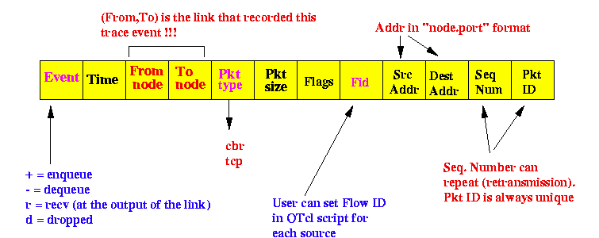
TraceFile Format

